Slide 1


KIET Group of Institutions, Ghaziabad
(An ISO – 9001: 2008 Certified & ‘A+’ Grade accredited Institution by NAAC)
II Project Presentation (KCS 753) YouTube Transcript Summarizer PCS-34
Guide Name: Prof. Vishaka Rana
Project Members:
1. Harsh Bhardwaj 7B [2000290120070]
2.Manish Tiwari 7B [2000290120091]
3. Ishita Goswami7A [2000290120079]

Slide 2


CONTENT
01
PROBLEM STATEMENT
02
OBJECTIVES
03
TECHNOLOGIES USED
04
WORKFLOW DIAGRAM
05
PATENT STATUS
06
RESEARCH PAPER STATUS
07
PROJECT STATUS
08
REFERENCES

Slide 3

PROBLEM STATEMENT
A large number of video recordings are made and shared online all day. It is very difficult to spend time watching such videos which may be longer than expected and sometimes our efforts may be in vain if we do not get the right information about it.
Summarize the text of those videos automatically allows us to quickly look at important patterns in the video and helps us save time and effort in all the content of the video.

Slide 4
OBJECTIVES
Convenience
Time-saving
Time-saving
To make it easier for viewers to quickly grasp the key points and main ideas of a video without having to watch the entire video.
To save users time by providing a summarized version of the video's content, especially for those who may not have the time to watch lengthy videos.
Accessibility
Content Overview
To enhance accessibility for individuals with hearing impairments by providing a textual summary of the video's content.
To offer users a quick overview of what the video is about, helping them decide whether they want to invest time in watching the full video.

Slide 5





TECHNOLOGY USED
Python‘s simplicity aids seamless integration with the YouTube API for transcript retrieval.
HTML, CSS is used to make the frontend of the chrome extension.
It is used for mathematical calculation of precise summary to generate.

Slide 6
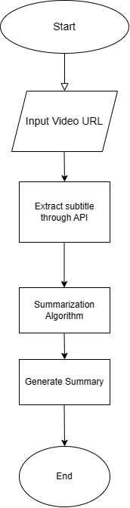
WORKFLOW DIAGRAM

Slide 7
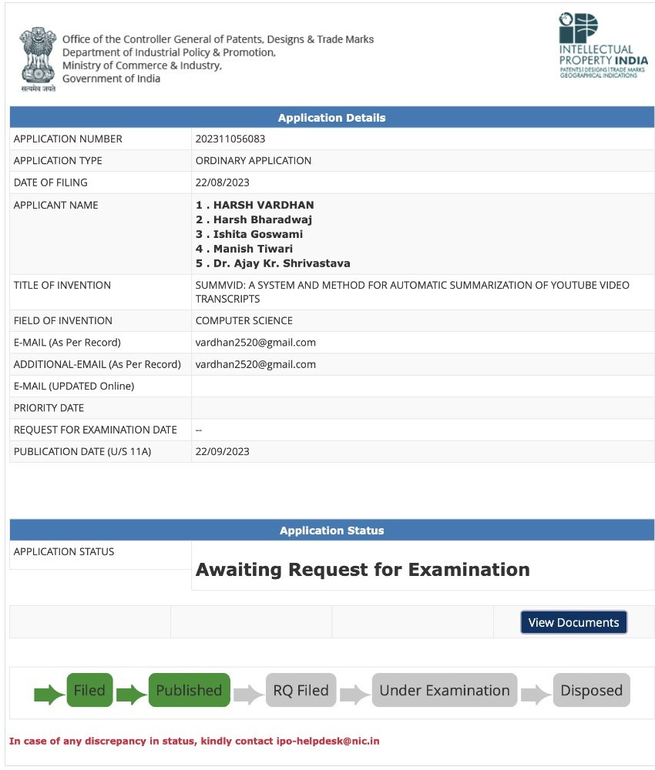
PATENT STATUS
Patent has been publish..!!!

Slide 8
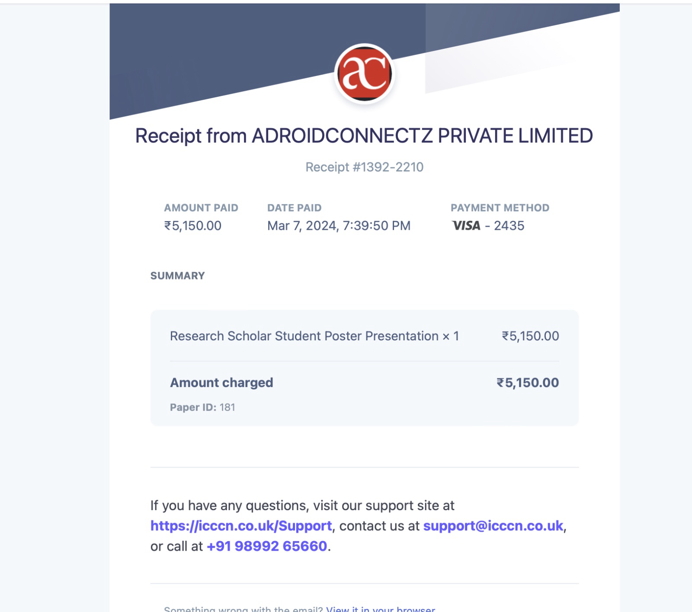

RESEARCH PAPER STATUS
Research paper accepted to conference and camera ready paper submitted.

Slide 9
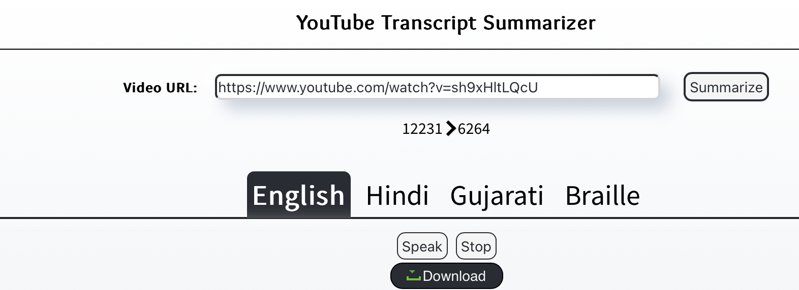
PROJECT STATUS
Our YouTube Transcript Summarizer project has reached an impressive 100% completion milestone and is working properly.

Slide 10
REFERENCES
[1] A. N. S. S. Vybhavi, L. V. Saroja, J. Duvvuru and J. Bayana, "Video Transcript Summarizer," 2022 International Mobile and Embedded Technology Conference (MECON), Noida, India, 2022, pp. 461-465, doi: 10.1109/MECON53876.2022.9751991.
[2] P. K. Biswas and A. Iakubovich, "Extractive Summarization of Call Transcripts," in IEEE Access, vol. 10, pp. 119826-119840, 2022, doi: 10.1109/ACCESS.2022.3221404.
[3] K. Kulkarni and R. Padaki, "Video Based Transcript Summarizer for Online Courses using Natural Language Processing," 2021 IEEE International Conference on Computation System and Information Technology for Sustainable Solutions (CSITSS), Bangalore, India, 2021, pp. 1-5, doi: 10.1109/CSITSS54238.2021.9683609.
[4] N. Moratanch and S. Chitrakala, "A Novel Framework for Semantic Oriented Abstractive Text Summarization," in Journal of Web Engineering, vol. 17, no. 8, pp. 675-715, December 2018, doi: 10.13052/jwe1540-9589.1784.
[5] Ying Li, Shih-Hung Lee, Chia-Hung Yeh and C. . -C. J. Kuo, "Techniques for movie content analysis and skimming: tutorial and overview on video abstraction techniques," in IEEE Signal Processing Magazine, vol. 23, no. 2, pp. 79-89, March 2006, doi: 10.1109/MSP.2006.1621451.
[6] S. R. Chauhan, S. Ambesange and S. G. Koolagudi, "Speech Summarization Using Prosodic Features and 1-D Convolutional Neural Network," 2022 IEEE 7th International Conference on Recent Advances and Innovations in Engineering (ICRAIE), MANGALORE, India, 2022, pp. 14-19, doi:10.1109/ICRAIE56454.2022.10054315.
[7] Rahul, S. Rauniyar and Monika, "A Survey on Deep Learning based Various Methods Analysis of Text Summarization," 2020 International Conference on Inventive Computation Technologies (ICICT), Coimbatore, India, 2020, pp. 113-116, doi: 10.1109/ICICT48043.2020.9112474.
[8] M. H. Bokaei, H. Sameti and Y. Liu, "Summarizing Meeting Transcripts Based on Functional Segmentation," in IEEE/ACM Transactions on Audio, Speech, and Language Processing, vol. 24, no. 10, pp. 1831-1841, Oct. 2016, doi: 10.1109/TASLP.2016.2585859.
[9] Gidiotis, A., & Tsoumakas, G. (2020). A divide-and-conquer approach to the summarization of long documents. IEEE/ACM Transactions on Audio, Speech, and Language Processing, 28, 3029-3040.

